Slide 1
Hibernate ORM
Technical sheets + quizz

Slide 2
Overview
Pros of JDBC | Cons of JDBC
Clean and simple SQL processing | Complex if it is used in large projects
Good performance with large data | Large programming overhead
Very good for small applications | No encapsulation
Simple syntax so easy to learn | Hard to implement MVC concept

Slide 3
Why Object Relational Mapping (ORM)?
Mismatch | Description
Granularity | Sometimes you will have an object model which has more classes than the number of corresponding tables in the database.
Inheritance | RDBMSs do not define anything similar to Inheritance which is a natural paradigm in object-oriented programming languages.
Identity | A RDBMS defines exactly one notion of 'sameness': the primary key. Java, however, defines both object identity (a==b) and object equality (a.equals(b)).
Associations | Object-oriented languages represent associations using object references where as am RDBMS represents an association as a foreign key column.
Navigation | The ways you access objects in Java and in a RDBMS are fundamentally different.

Slide 4
What is an ORM?
S.N. | Advantages
1 | Lets business code access objects rather than DB tables.
2 | Hides details of SQL queries from OO logic.
3 | Based on JDBC 'under the hood'
4 | No need to deal with the database implementation.
5 | Entities based on business concepts rather than database structure.
6 | Transaction management and automatic key generation.
7 | Fast development of application.

Slide 5
Furthermore
S.N. | Solutions
1 | An API to perform basic CRUD operations on objects of persistent classes.
2 | A language or API to specify queries that refer to classes and properties of classes.
3 | A configurable facility for specifying mapping metadata.
4 | A technique to interact with transactional objects to perform dirty checking, lazy association fetching, and other optimization functions.

Slide 6
You dirty bastard!
Dirty, in persistence context, means that the database state has been changed since the last update, so the data is not consistent between Java application and DB Engine.

Slide 7
Lazy … ? *YAWNS*
Lazy, in persistence context, means that all associations are fetched on the first query, regardless of their usefulness in the context.

Slide 8
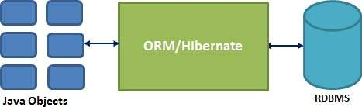
Schematic

Slide 9
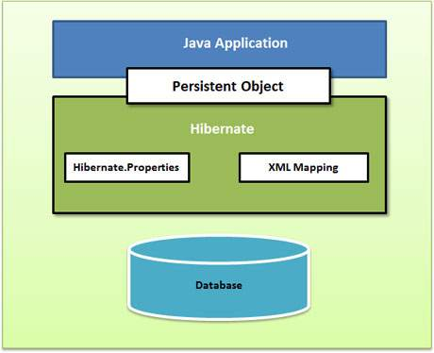

Slide 10
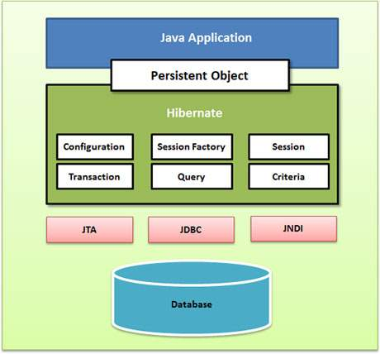

Slide 11
Configuration object
The Configuration object provides two keys components:
Database Connection: This is handled through one or more configuration files supported by Hibernate. These files are hibernate.properties and hibernate.cfg.xml.
Class Mapping Setup
This component creates the connection between the Java classes and database tables..

Slide 12
SessionFactory Object
Configuration object is used to create a SessionFactory object which inturn configures Hibernate for the application using the supplied configuration file and allows for a Session object to be instantiated. The SessionFactory is a thread safe object and used by all the threads of an application.
The SessionFactory is heavyweight object so usually it is created during application start up and kept for later use. You would need one SessionFactory object per database using a separate configuration file. So if you are using multiple databases then you would have to create multiple SessionFactory objects.

Slide 13
Session Object
A Session is used to get a physical connection with a database. The Session object is lightweight and designed to be instantiated each time an interaction is needed with the database. Persistent objects are saved and retrieved through a Session object.
The session objects should not be kept open for a long time because they are not usually thread safe and they should be created and destroyed them as needed.

Slide 14
Transaction Object
A Transaction represents a unit of work with the database and most of the RDBMS supports transaction functionality. Transactions in Hibernate are handled by an underlying transaction manager and transaction (from JDBC or JTA).
This is an optional object and Hibernate applications may choose not to use this interface, instead managing transactions in their own application code.

Slide 15
Query Object
Query objects use SQL or Hibernate Query Language (HQL) string to retrieve data from the database and create objects. A Query instance is used to bind query parameters, limit the number of results returned by the query, and finally to execute the query.

Slide 16
Criteria Object
Criteria object are used to create and execute object oriented criteria queries to retrieve objects.

Slide 17
Hibernate properties
S.N. | Properties and Description
1 | hibernate.dialect This property makes Hibernate generate the appropriate SQL for the chosen database.
2 | hibernate.connection.driver_class The JDBC driver class.
3 | hibernate.connection.url The JDBC URL to the database instance.
4 | hibernate.connection.username The database username.
5 | hibernate.connection.password The database password.
6 | hibernate.connection.pool_size Limits the number of connections waiting in the Hibernate database connection pool.
7 | hibernate.connection.autocommit Allows autocommit mode to be used for the JDBC connection.

Slide 18
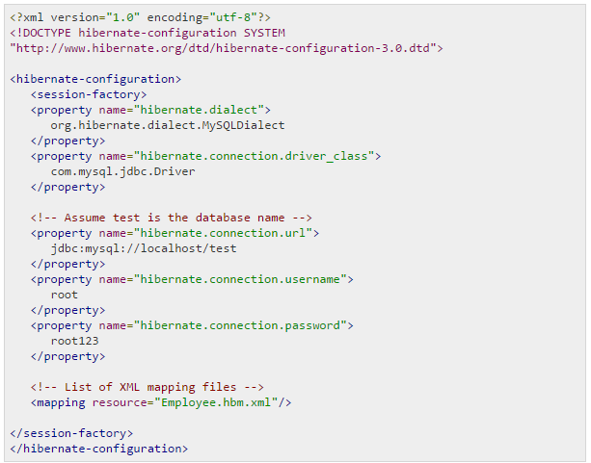

Slide 19
Object states
transient: A new instance of a persistent class which is not associated with a Session and has no representation in the database and no identifier value is considered transient by Hibernate.
persistent: You can make a transient instance persistent by associating it with a Session. A persistent instance has a representation in the database, an identifier value and is associated with a Session.
detached: Once we close the Hibernate Session, the persistent instance will become a detached instance.

Slide 20
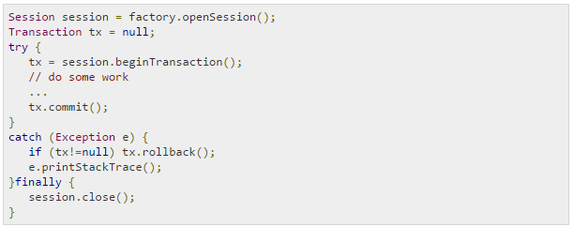
Typical Transaction

Slide 21
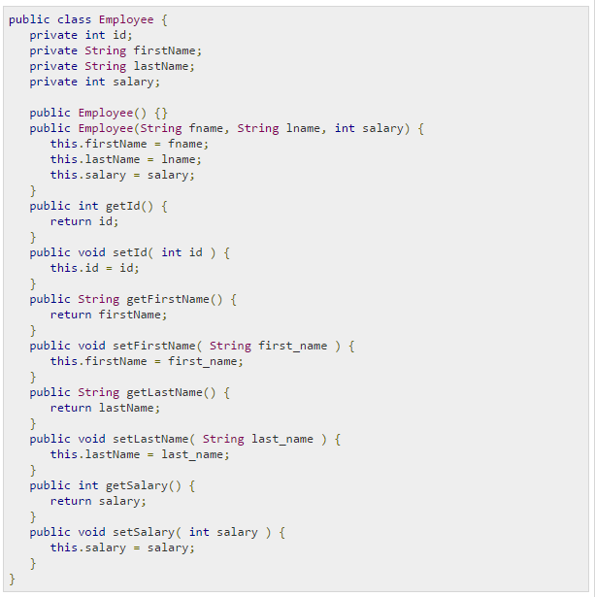

Slide 22
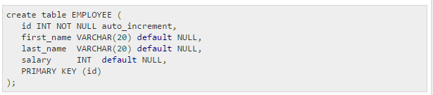

Slide 23
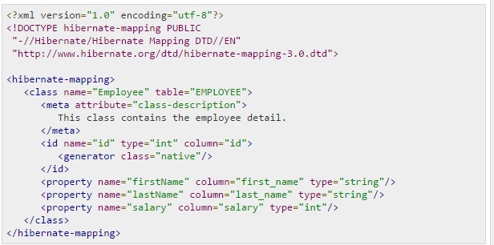

Slide 24


Slide 25
Association Mappings
Many-to-One
One-to-One
One-to-Many
Many-to-Many

Slide 26
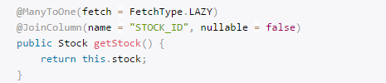

Slide 27
Component Mappings
It is very much possible that an Entity class can have a reference to another class as a member variable. If the referred class does not have it's own life cycle and completely depends on the life cycle of the owning entity class, then the referred class hence therefore is called as the Component class.
The mapping of Collection of Components is also possible in a similar way just as the mapping of regular Collections with minor configuration differences. We will see these two mappings in detail with examples.

Slide 28
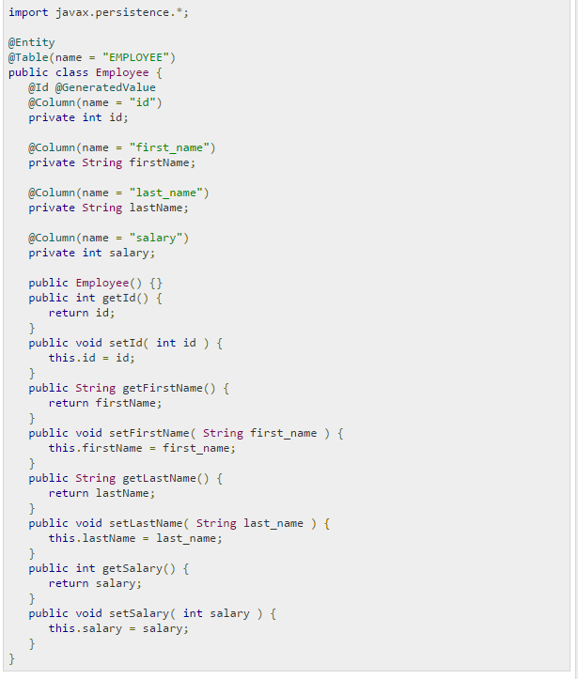

Slide 29


Slide 30

FROM Clause

Slide 31

AS clause

Slide 32

SELECT clause

Slide 33

WHERE clause

Slide 34

Order by clause

Slide 35

Named parameters (prepared statement)

Slide 36
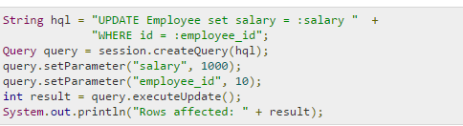
Update clause

Slide 37
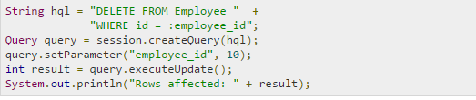
Delete clause

Slide 38
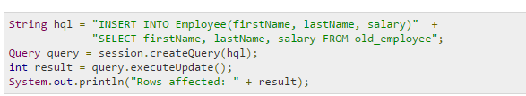
Insert clause

Slide 39

pagination

Slide 40
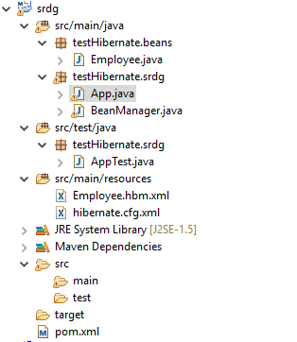
Project structure

Slide 41
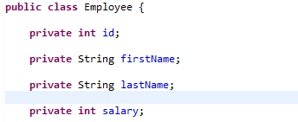
Employee class

Slide 42
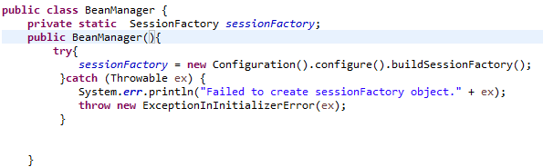
Bean manager class

Slide 43
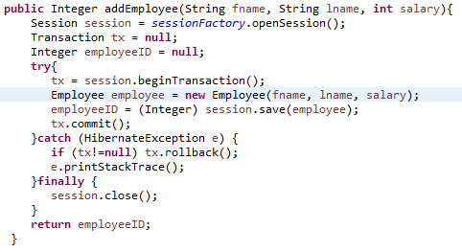
Add employee method

Slide 44
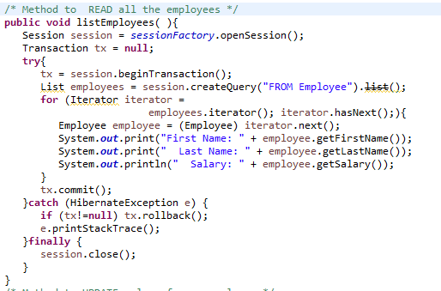
listEmployees method

Slide 45
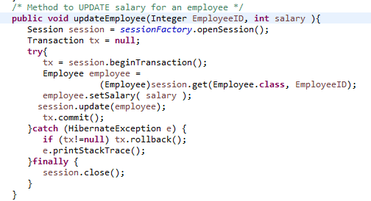
Updateemployee method

Slide 46
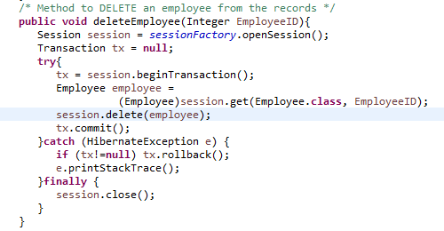
Deleteemployee method

Slide 47
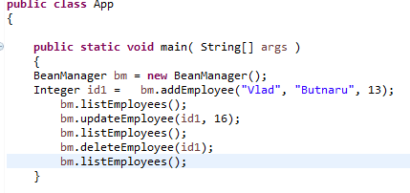
App class

Slide 48
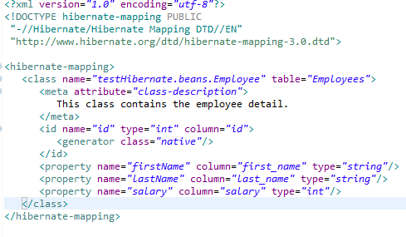
Employee.hmb.xml file

Slide 49
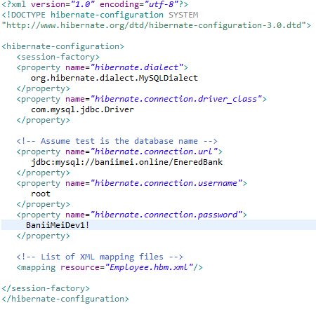
Hibernate.cfg.xml file

Slide 50
Quizz
What is a SessionFactory?

Slide 51
Quizz
What is a Session?

Slide 52
Quizz
What is a Transaction?

